Slide 1
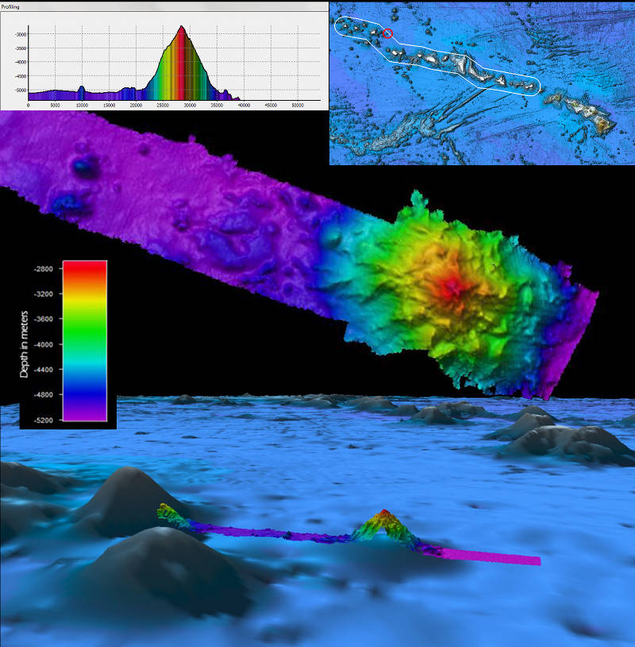
Wet Maps

Slide 2
Wet Maps - Introduction
Driving Question
How do scientists create and use maps to help them identify features on the ocean floor?
Let’s think about it!
How do we know what the seafloor looks like deep below the sea surface?
What tools have been developed to make it easier to visualize the seafloor?
What is sonar? How do you think it works?
What do you think “multibeam” means? How does it differ from a single beam?

Slide 3
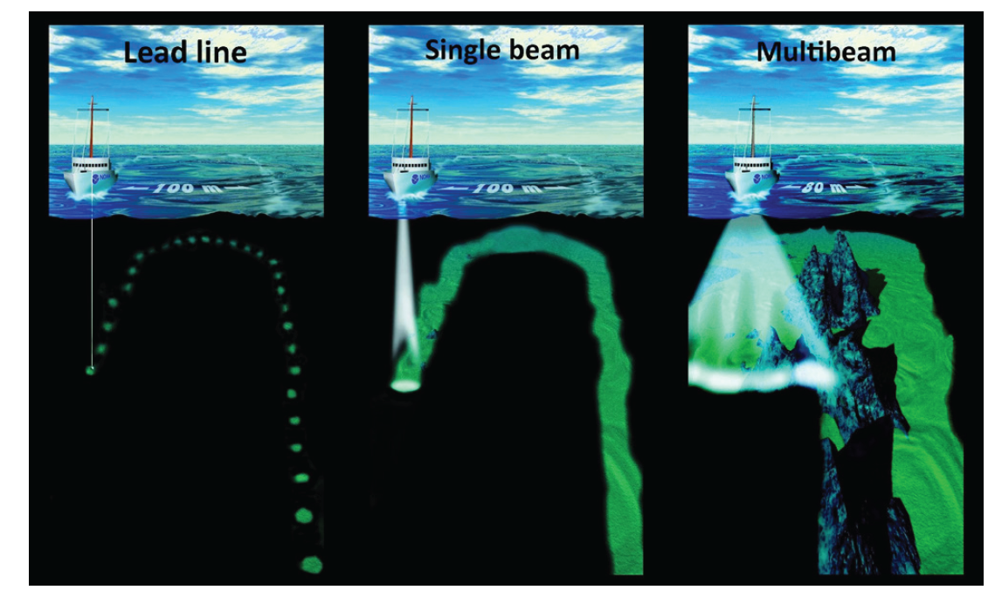
Advancements in Seafloor Mapping
Adapted from the Canadian Hydrographic Service.

Slide 4
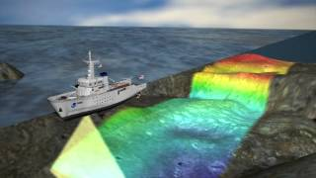
Advancements in Seafloor Mapping

Slide 5
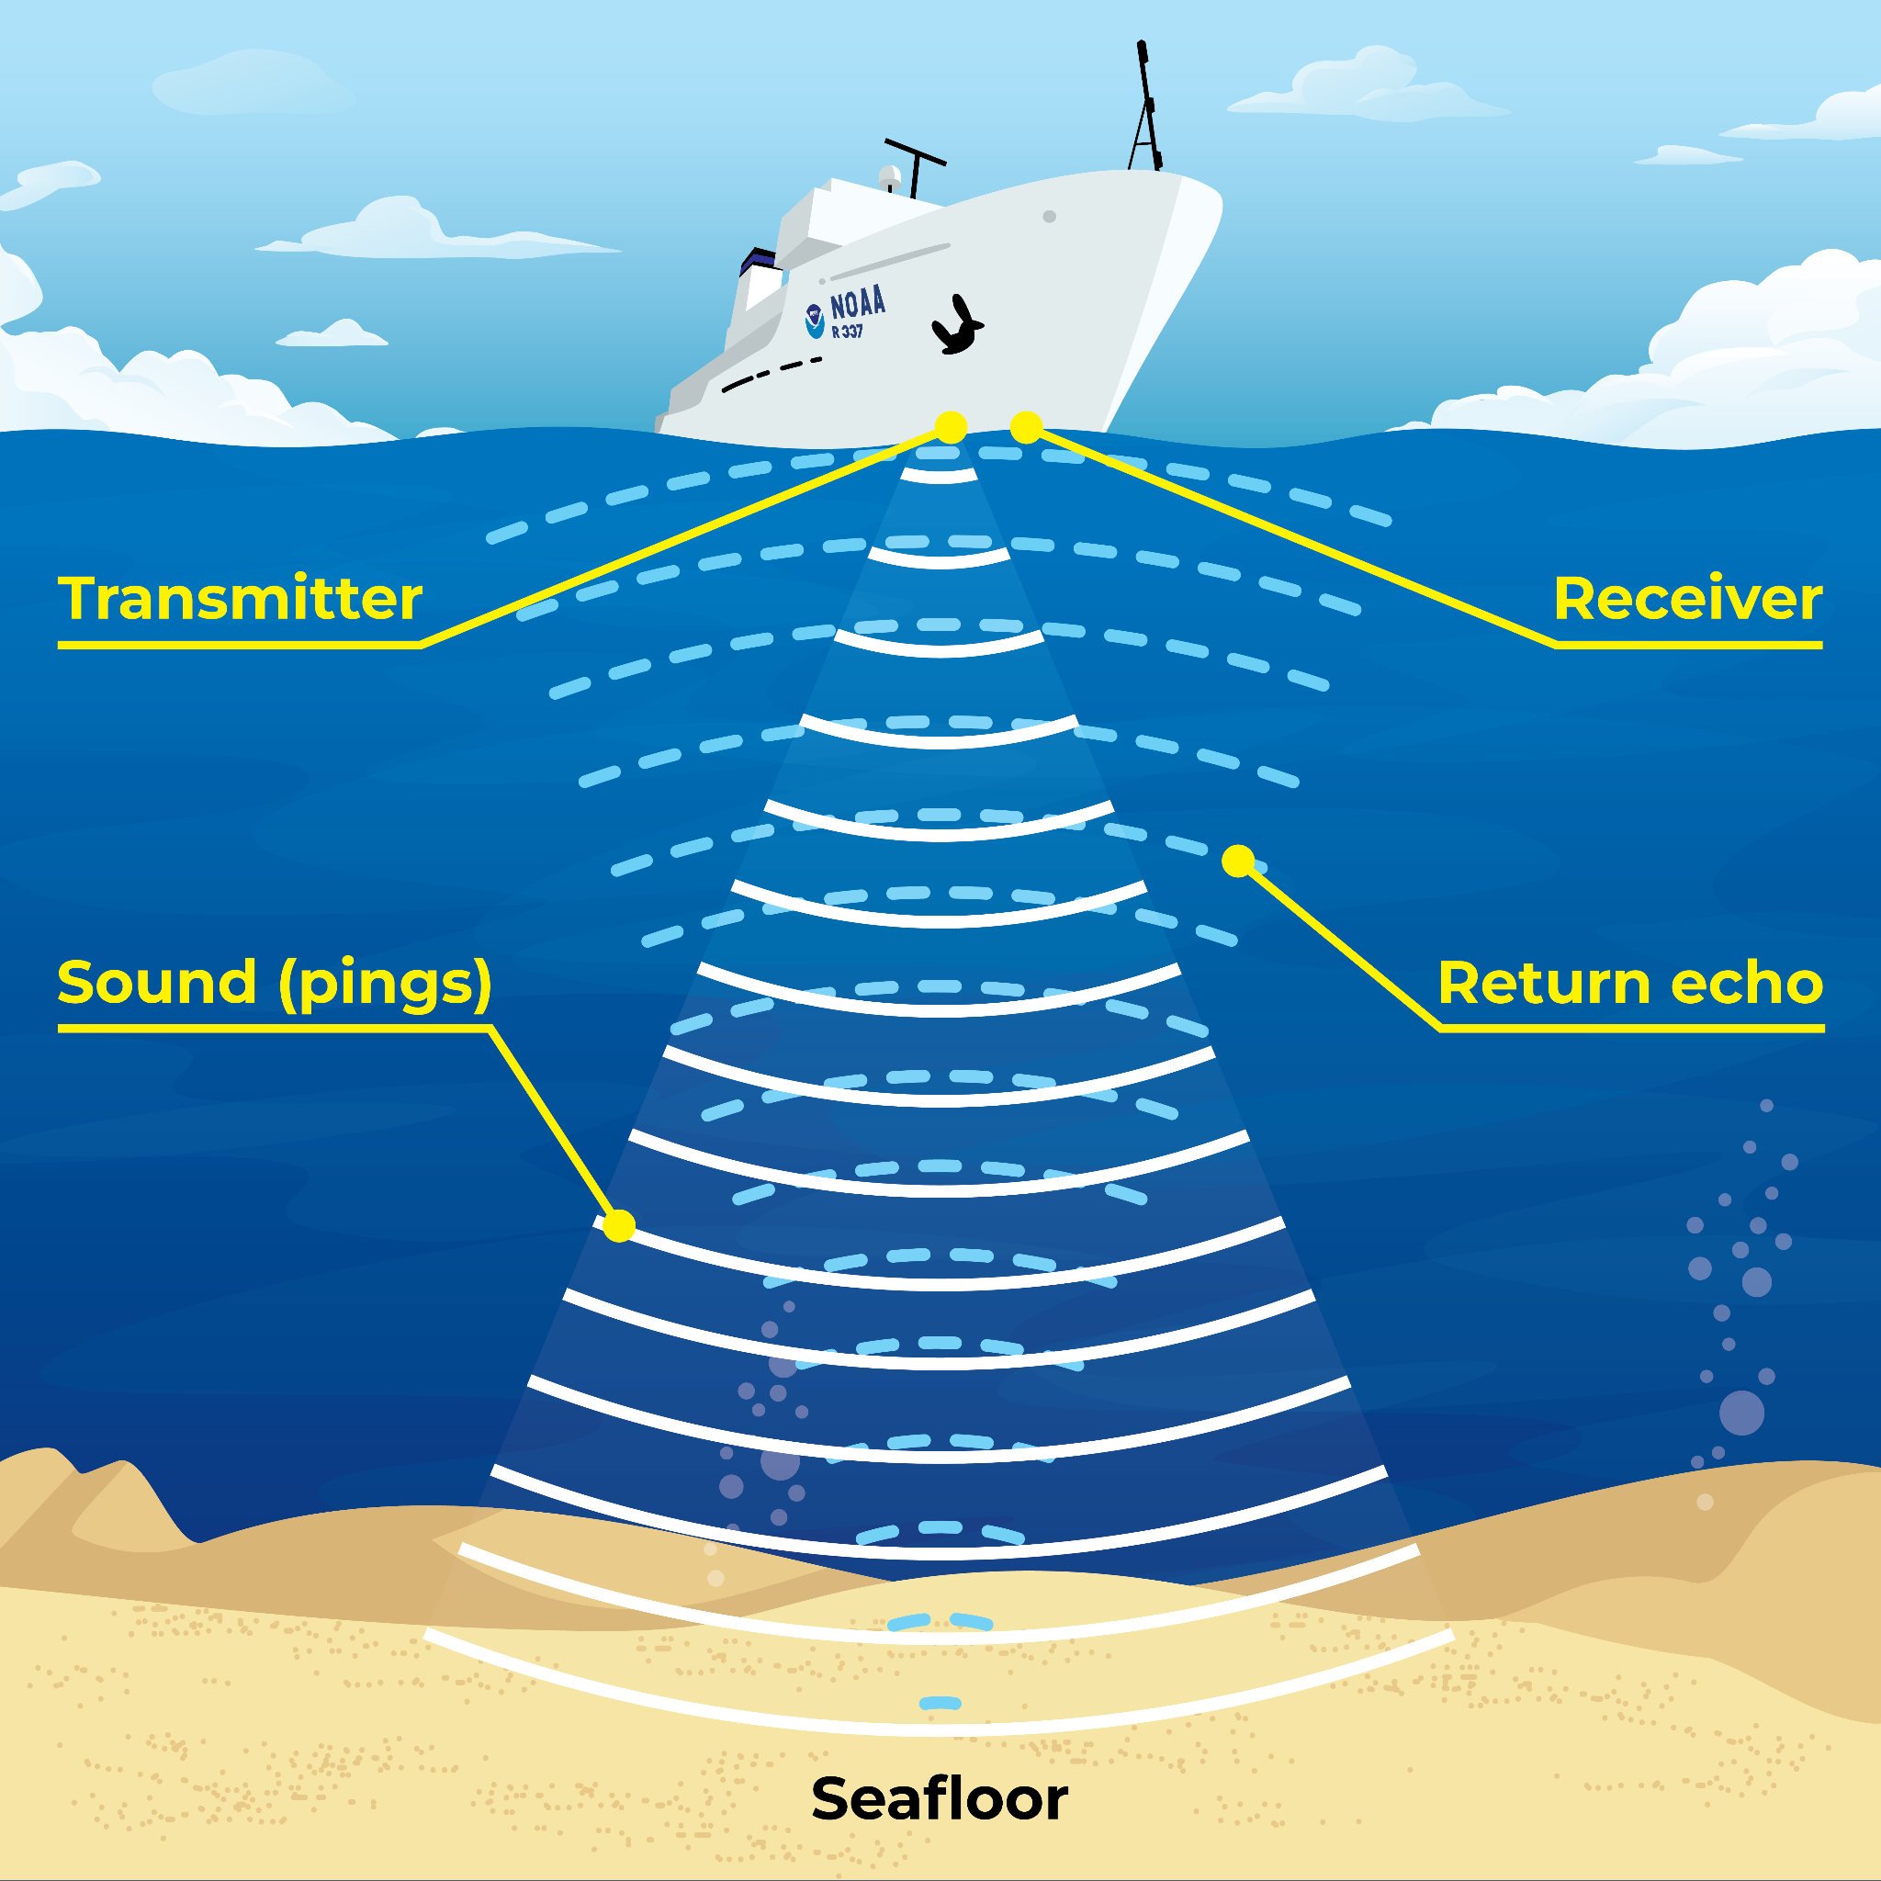
Wet Maps - Introduction

Slide 6
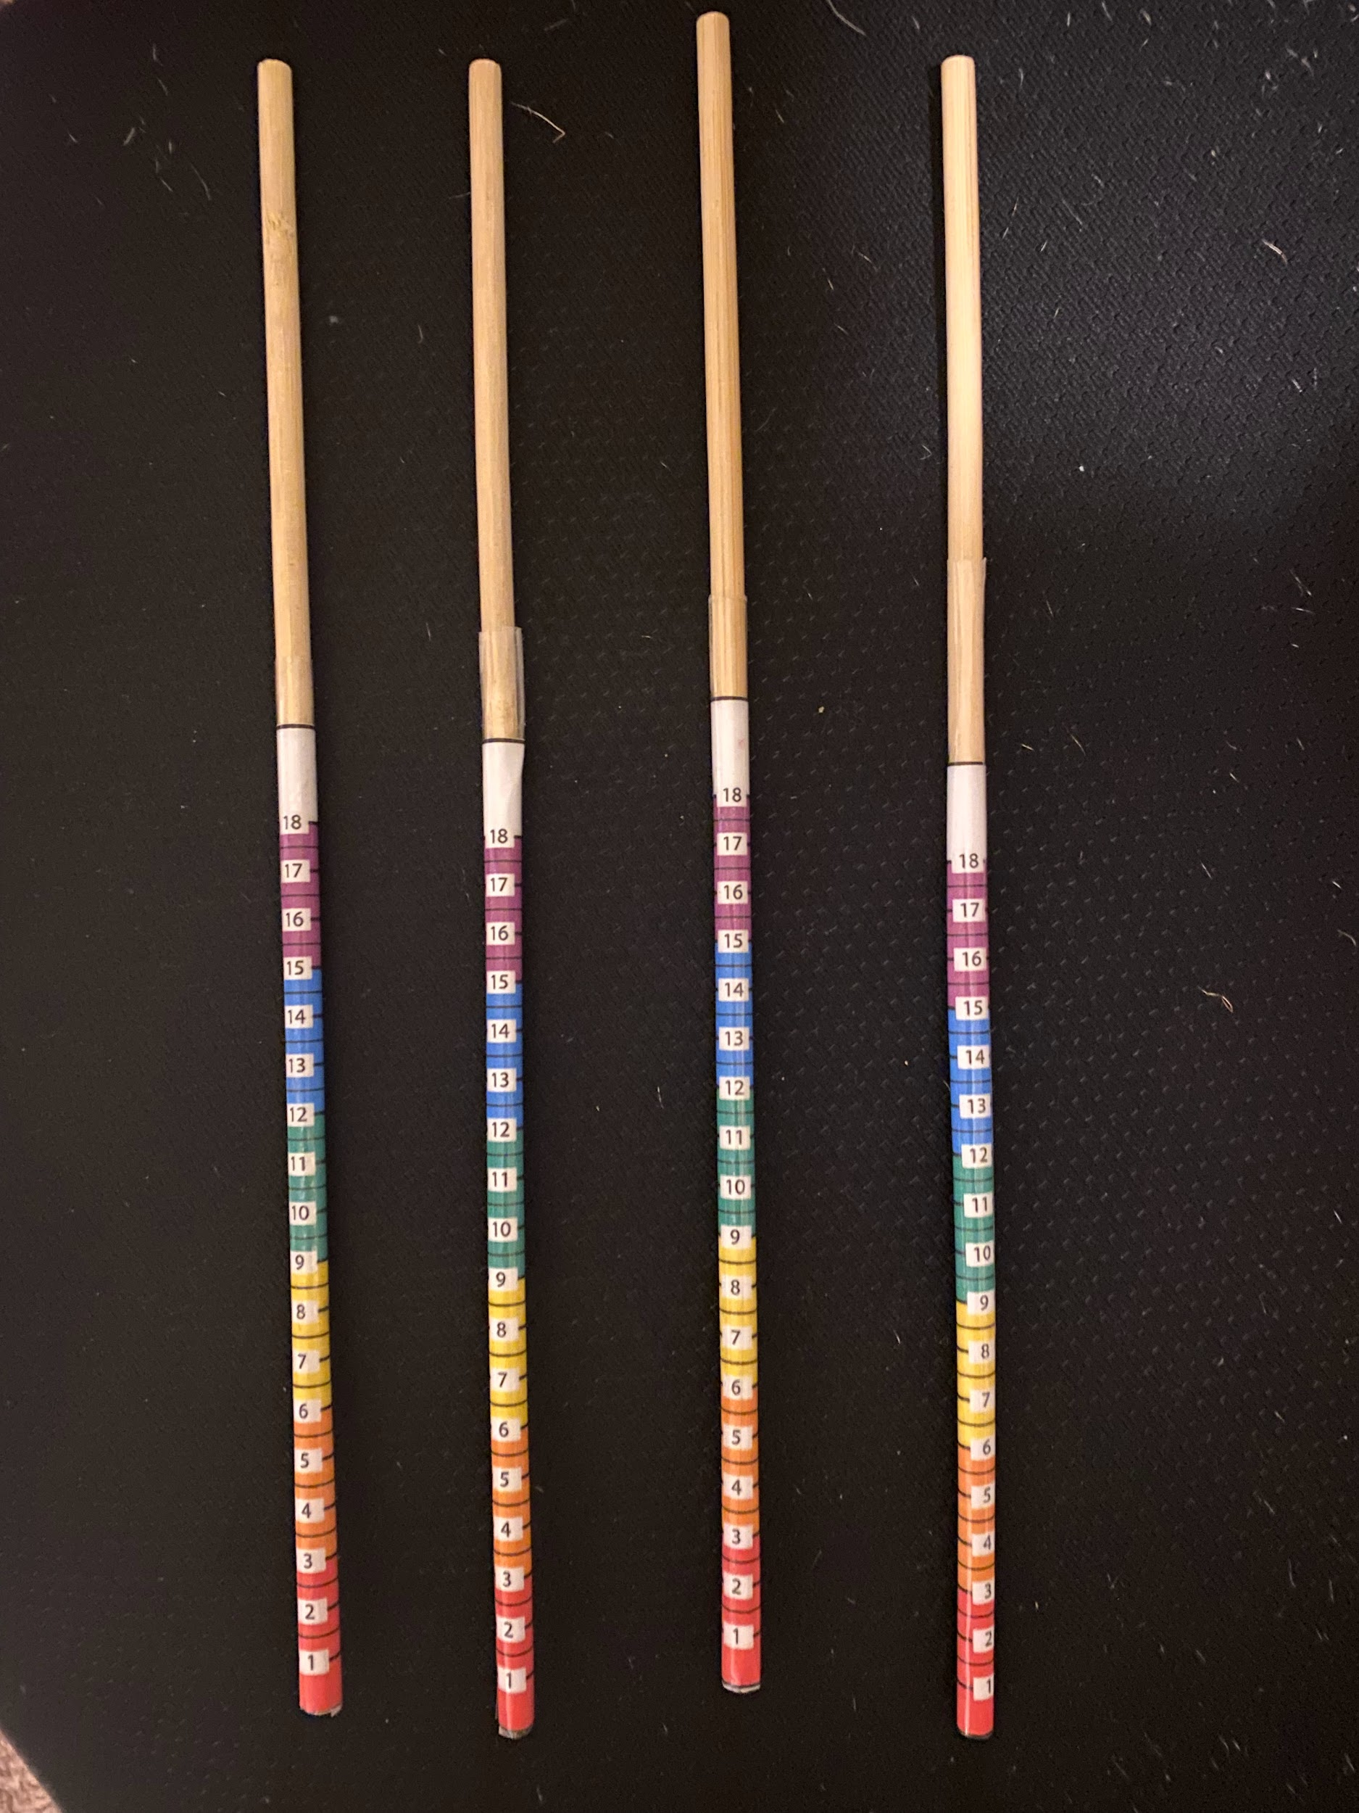

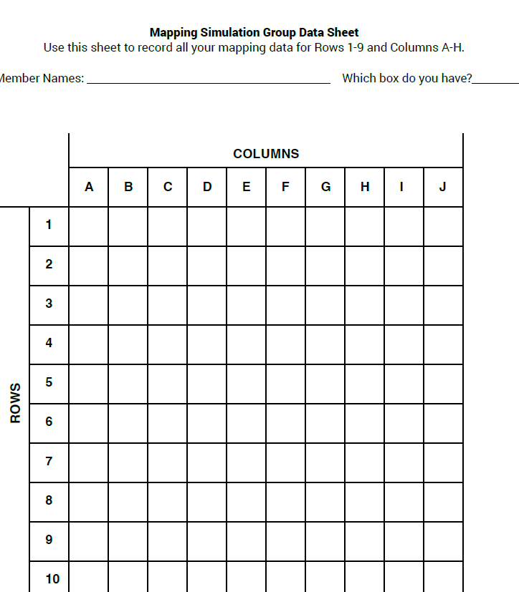
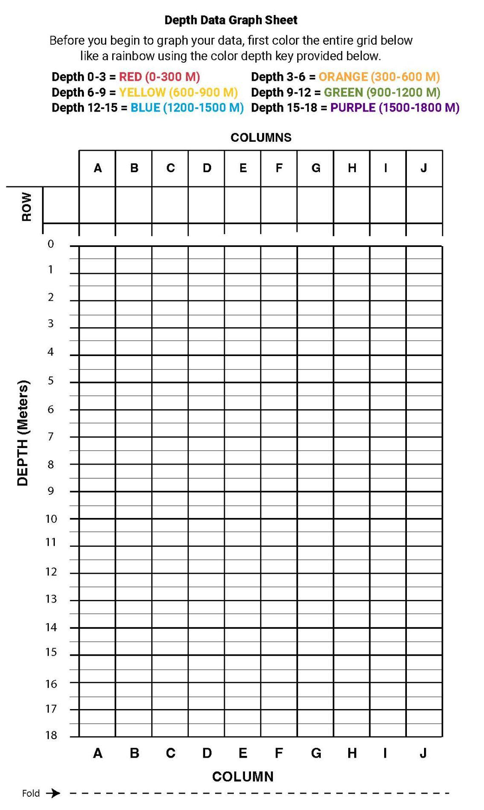
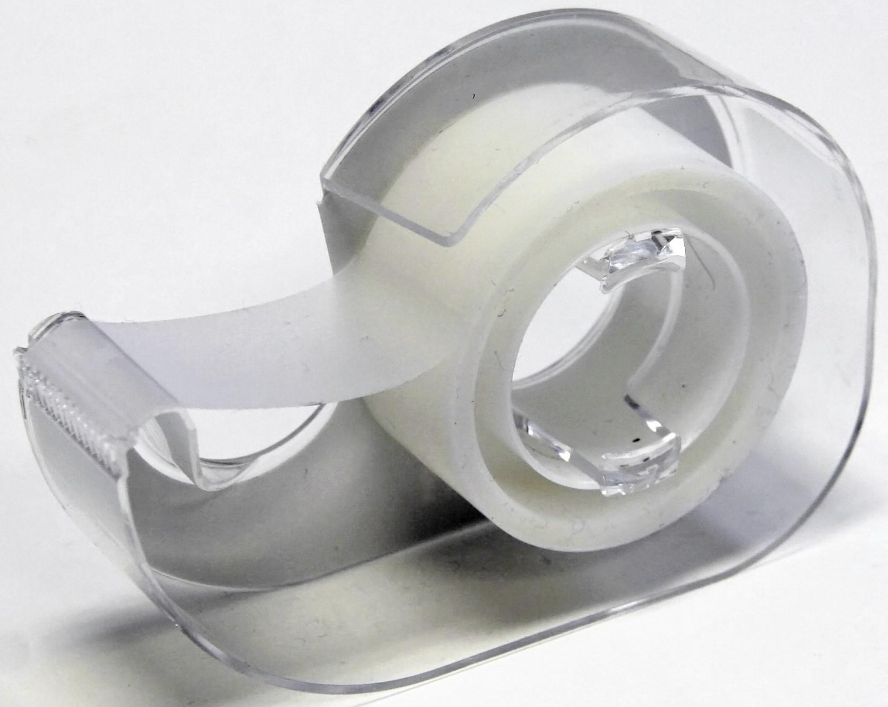
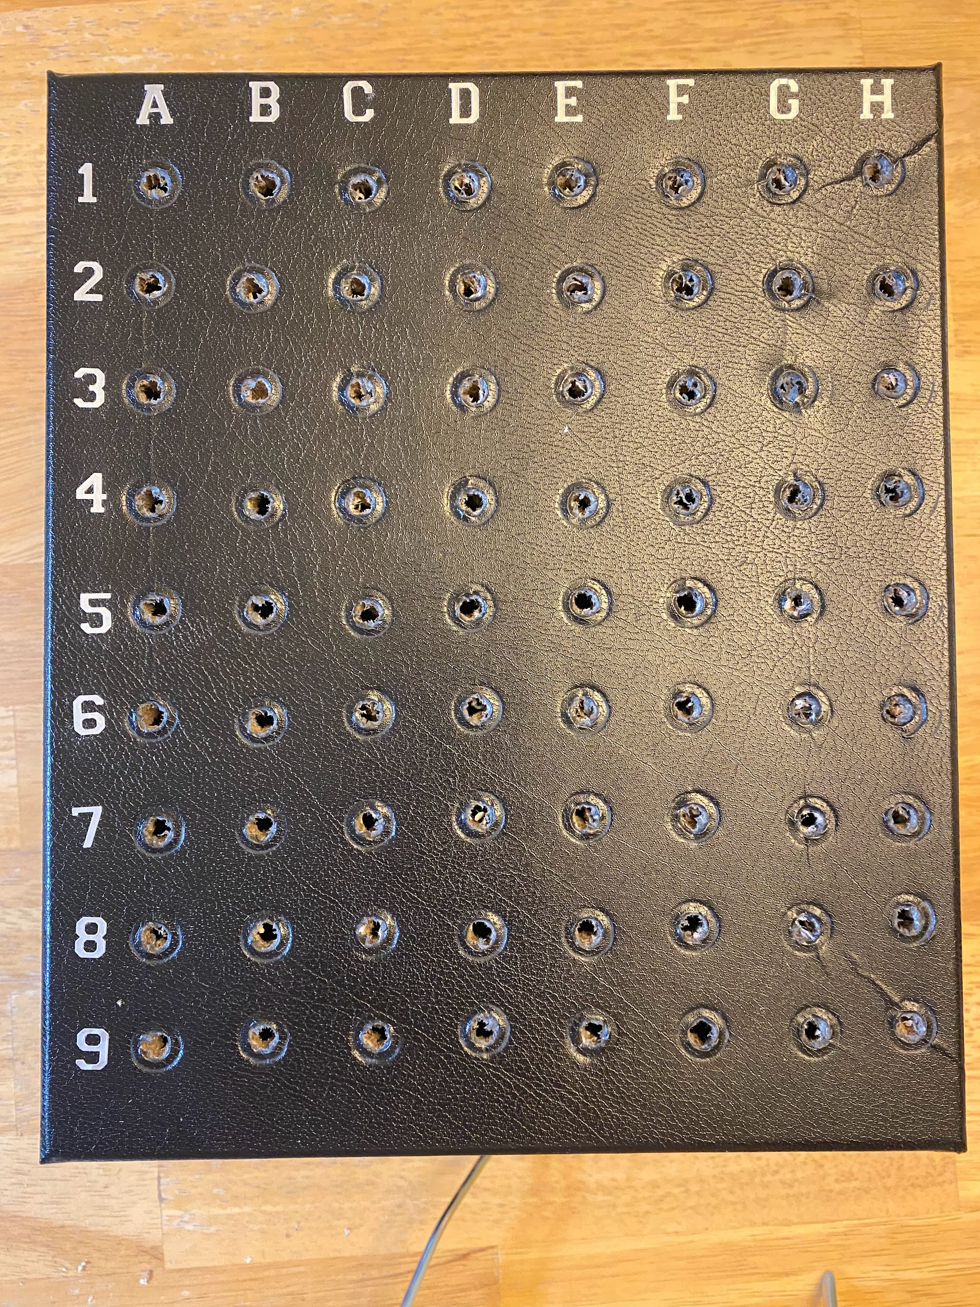


Wet Maps - Materials

Slide 7

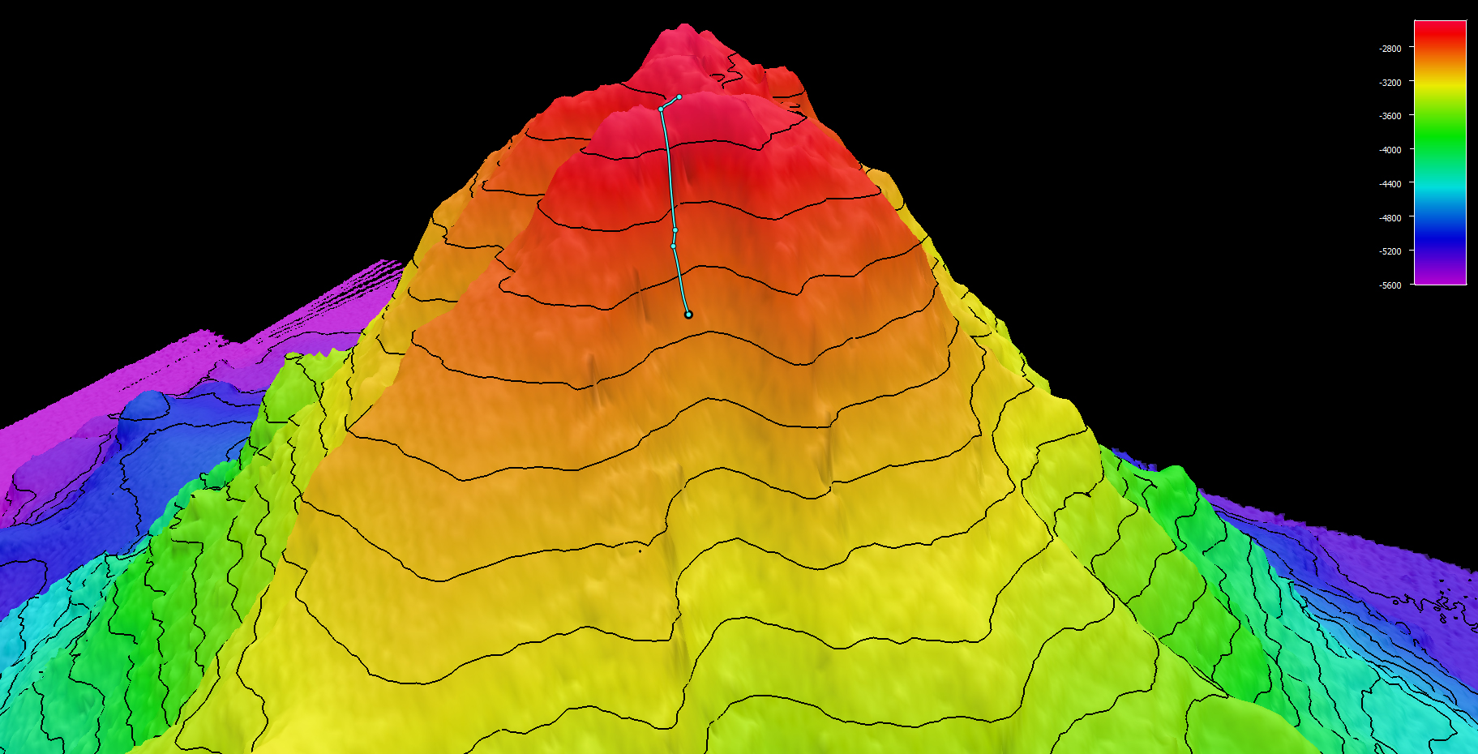
Wet Maps - Learning Procedure
What do the pencils/wooden dowels represent?
Which way should you insert rods into the box? Why?

Slide 8
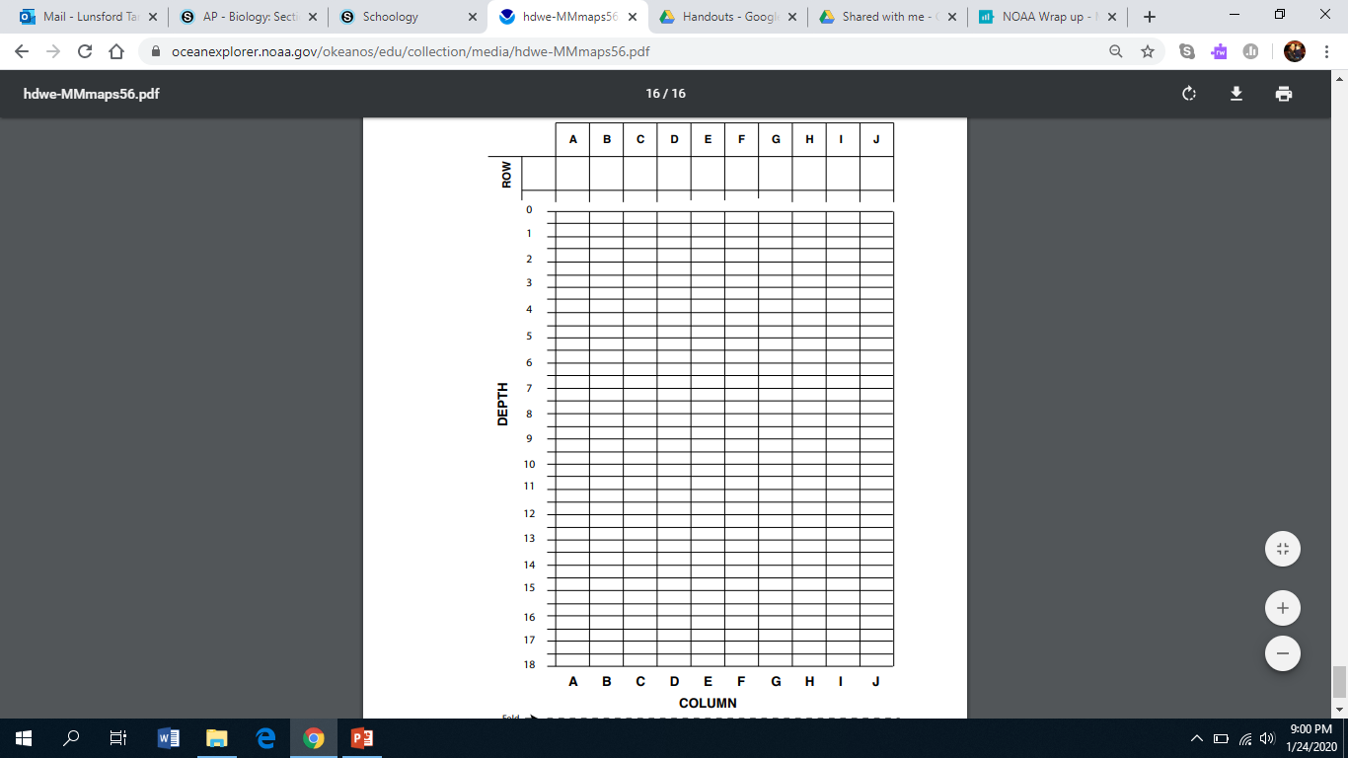
Wet Maps - Learning Procedure

Slide 9
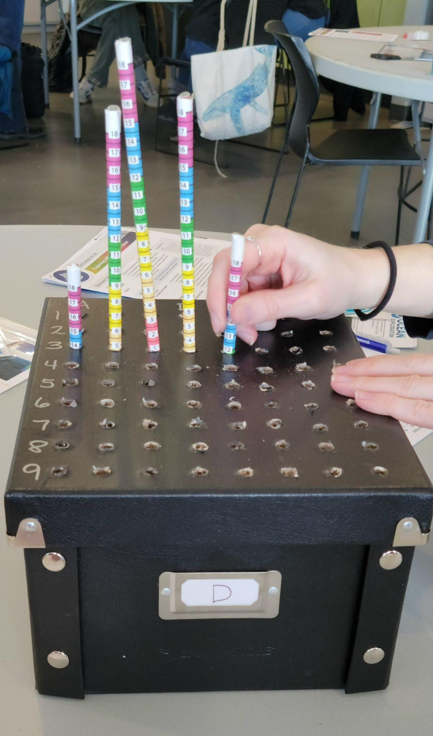
Wet Maps - Learning Procedure
Let’s Map!

Slide 10
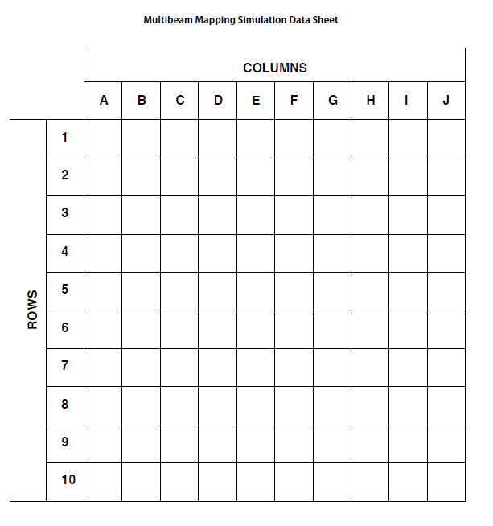
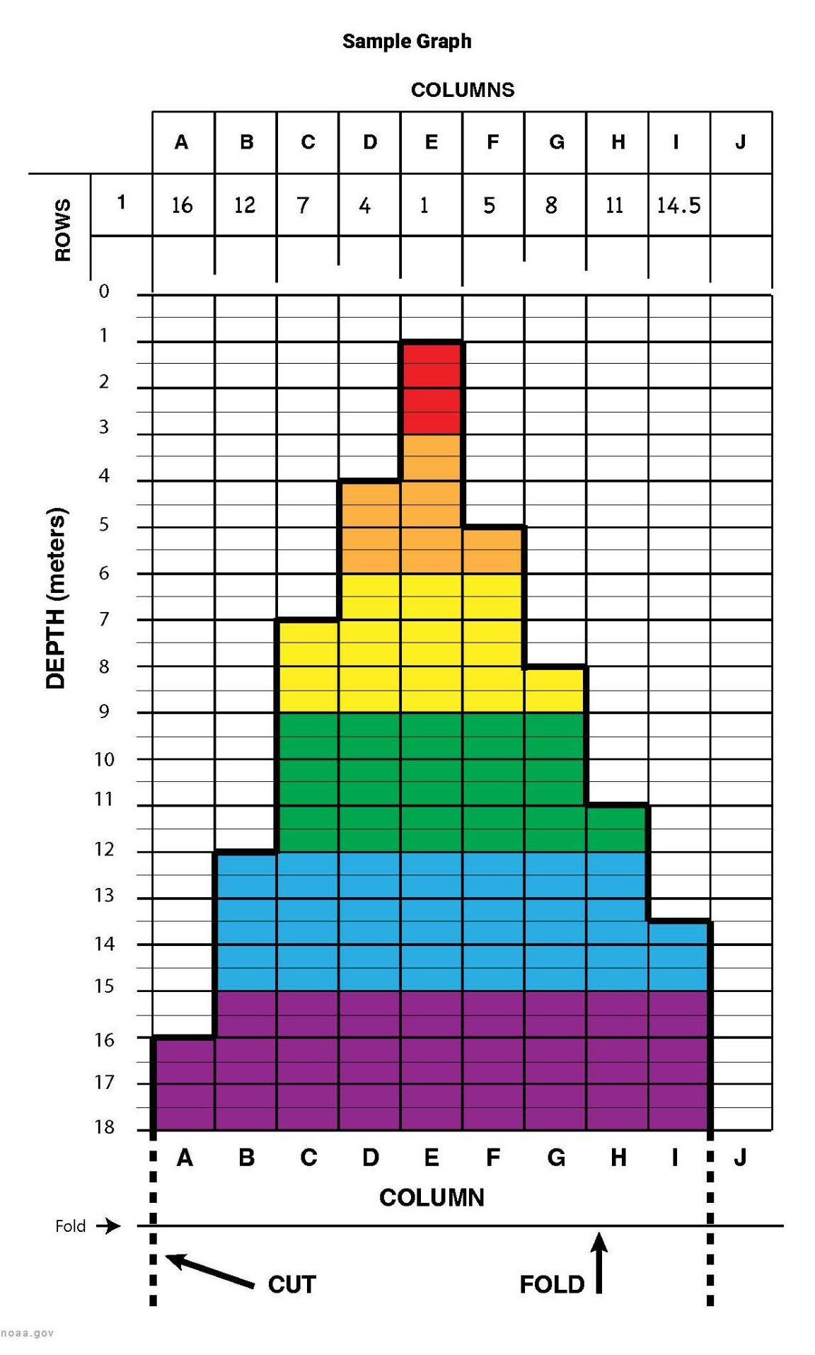
Wet Maps - Learning Procedure

Slide 11
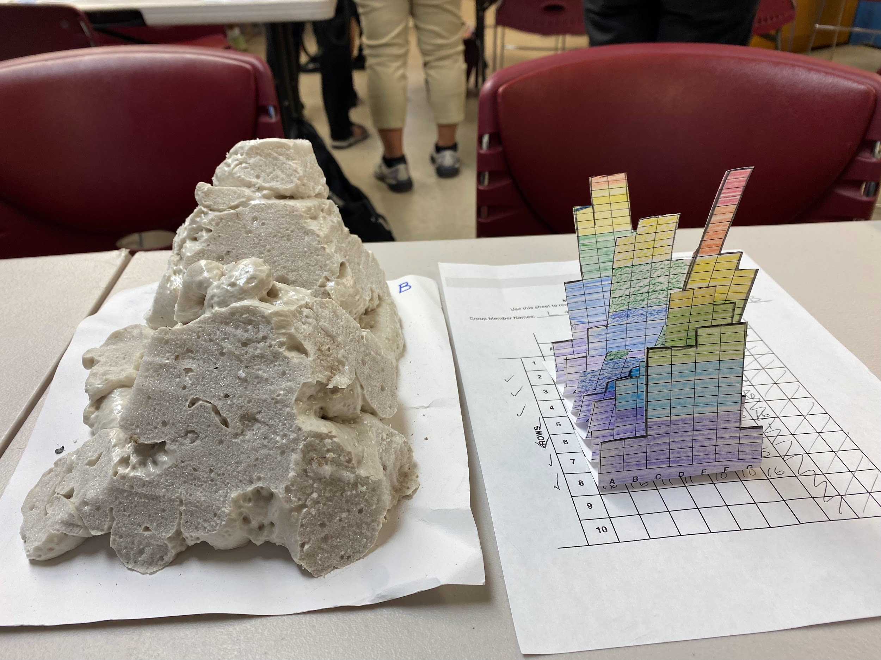
Wet Maps - Learning Procedure

Slide 12
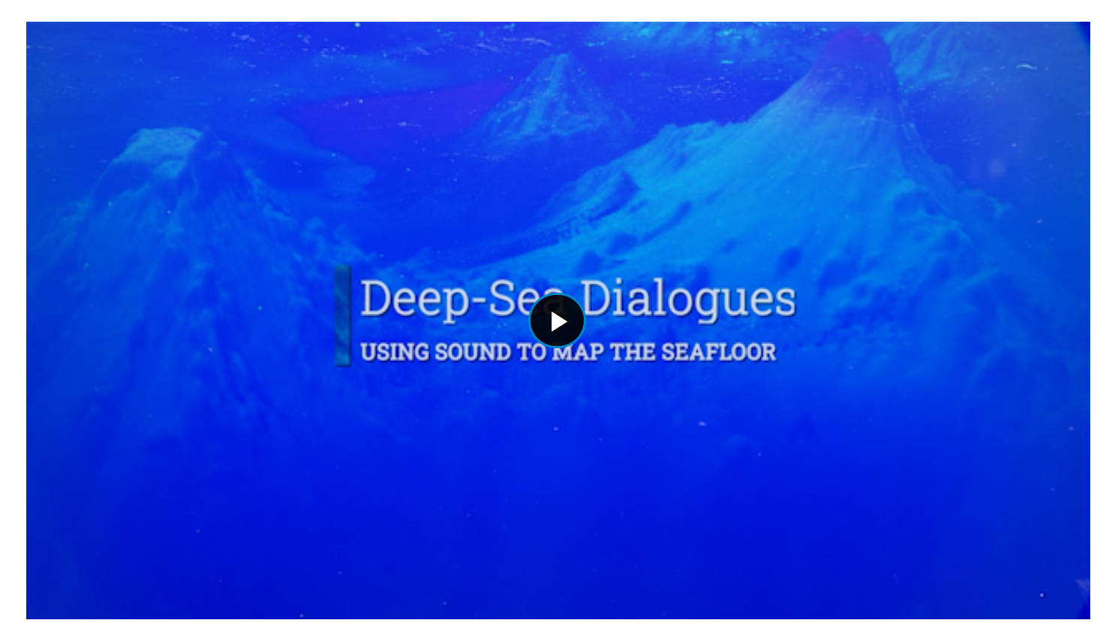
Wet Maps - Putting the Pieces Together
https://oceanexplorer.noaa.gov/edu/multimedia-resources/dsd/media/2023-DSD-Mapping-v6-1920x1080.mp4

